Slide 1
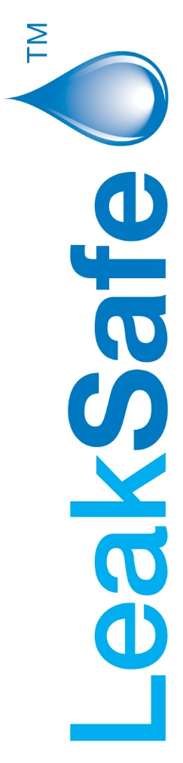
Proving the benefits of installing LeakSafe

Slide 2
A property with a poor water damage history will not see an improvement in its claims
record until something is done about the problem.
It will get worse as the property, its plumbing and fittings get older as we understand that
The principal source of the leaks are, as is the case with most residential blocks, the pipework
and associated fittings i.e. bathrooms, kitchens, utility rooms boilers etc.
We understand the position at Warren House is exacerbated by the fact that a proportion of
apartments are a London base for people who spend extended periods abroad.
The options to improve the position are essentially ;
Re-plumb the property
Install a leak detection system

Slide 3
Do LeakSafe systems deliver the benefits claimed for them ?
The next slides are from data provided by RSA and Jelf (the latter being part of Marsh Insurance
Brokers) on three installations. All are residential blocks proving the benefits of installing LeakSafe.
Clients and insurers will not reveal how much excesses and premiums are reduced for the
installation of LeakSafe systems as this is confidential between the parties & commercially
sensitive but AXA and Zurich will, in our experience, offer significantly better terms than would
otherwise be the case.
Over the longer term the improved claims history creates a competitive environment at renewal.
With performance targets to hit insurers are attracted to large residential blocks with their large
premiums other than for the fact that historically this augment has suffered significant water
damage claims. By installing a leak detection system the block overcomes the single biggest barrier
to improved insurance policy terms

Slide 4

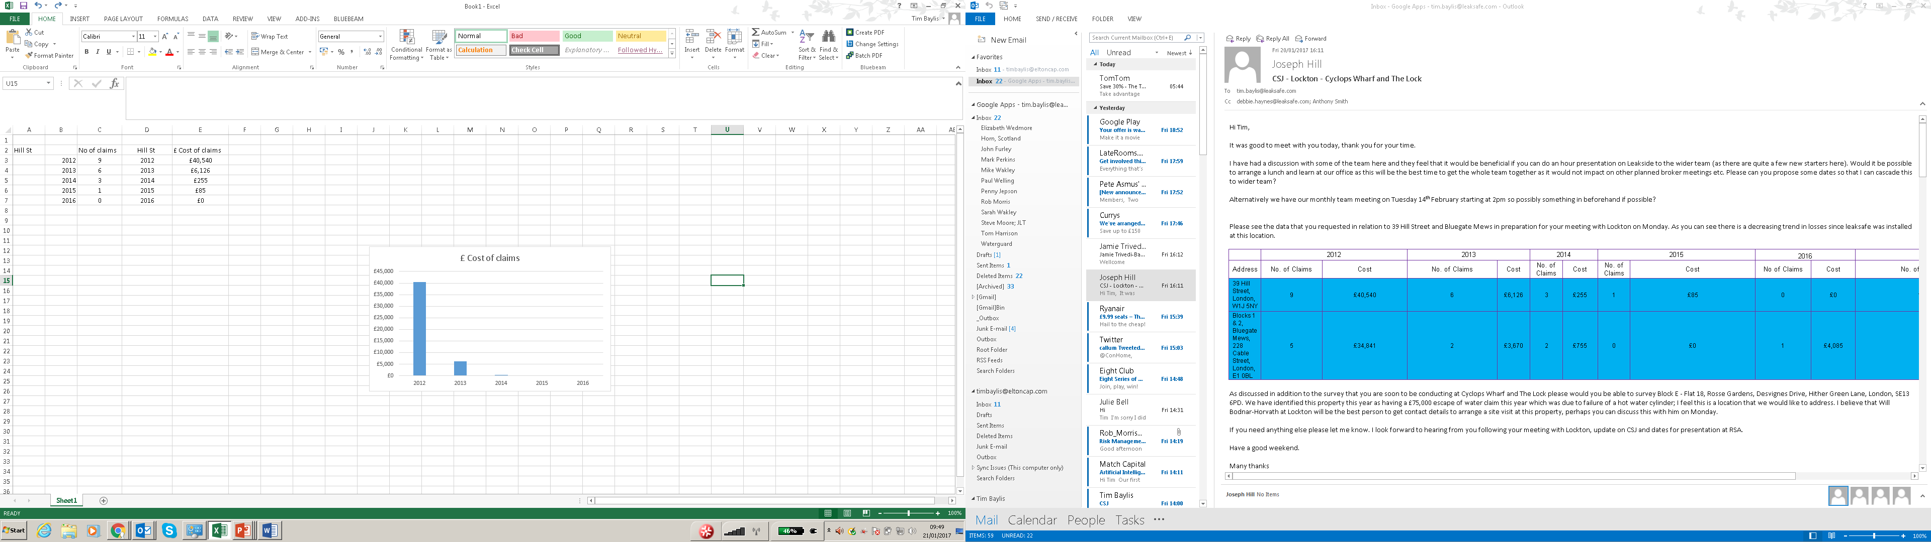
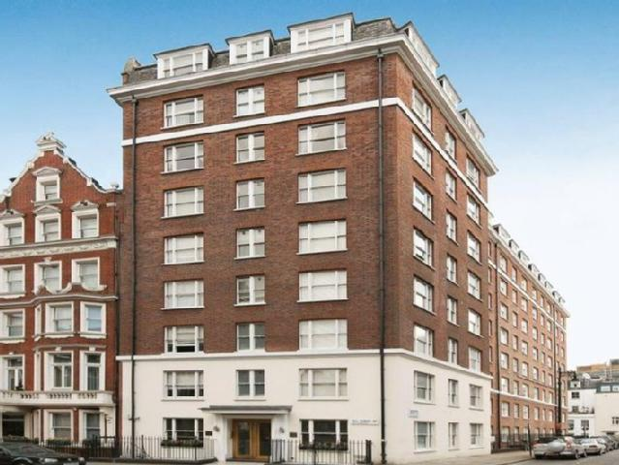

Year | £ Cost of claims
2012 | £40,540
2013 | £6,126
2014 | £255
2015 | £85
2016 | £0
Installation of LeakSafe
Year | No. of claims
2012 | 9
2013 | 6
2014 | 3
2015 | 1
2016 | 0
Installation of LeakSafe

Slide 5

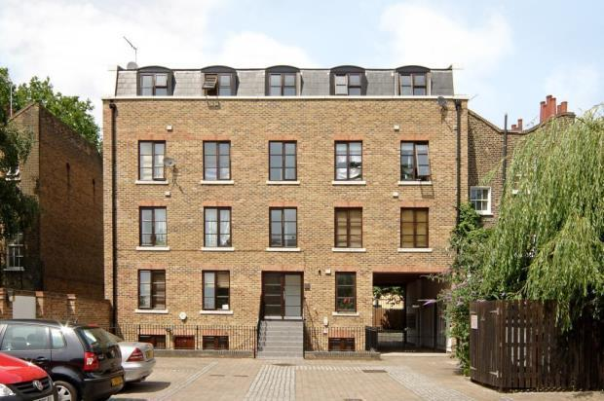

Installation of LeakSafe
Year | £ Cost of claims
2012 | £34,841
2013 | £3,670
2014 | £755
2015 | £0
2016 | £4,085
Installation of LeakSafe
Year | No. of claims
2012 | 5
2013 | 2
2014 | 2
2015 | 0
2016 | 1

Slide 6

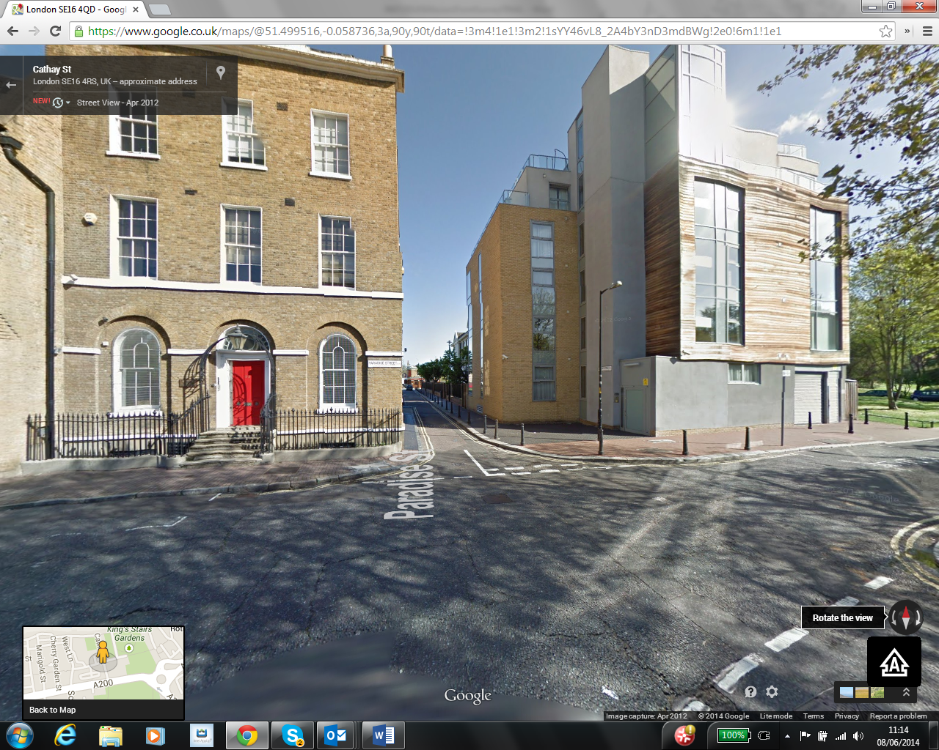
Year | No. of EOW claims
2012 | 1
2013 | 3
2014 | 2
2015 | 0
2016 | 0
Installation of LeakSafe
3 years 6 claims ; £142,231
£0 since LeakSafe installation
Installation of LeakSafe
Year | £ Cost of EOW claims
2012 | £ 6,073
2013 | £64,031
2014 | £72,127
2015 | £0
2016 | £0

Slide 7
How quickly are the benefits delivered ?
The next two slides show how immediately after installation the benefits of
LeakSafe are experienced
In properties with a poor history of water damage it is quite normal for leaks to be detected
as the LeakSafe installers are installing the tapes.

Slide 8
Immediacy of response; Mission Point
Installation
14 Apartments
Traditional construction
Plastic push-fit pipework
Repaired as detected by LeakSafe
No further claims; all below excess

Slide 9
3-4 leaks/month
in 124 student flats
Installation
12 months
38 leaks
Notes:
Installing system that provide long term benefits but have an immediate and beneficial impact for contractors

Slide 10
What is the client experience of LeakSafe systems installed in their ?
The following testimonials cover a wide range of property types demonstrating the effectiveness
of the system and the performance of the LeakSafe Approved Installers.

Slide 11
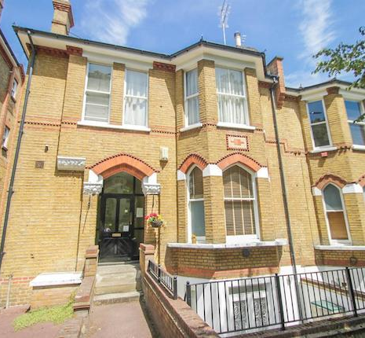
Property Investment Co. : Managing Director
Unsolicited testimonial
“As far as the worth of the LeakSafe technology is concerned, speaking as the freeholder … I can state that the management time …expended dealing with water leaks since completion of the installation of the LeakSafe system is nil, compared with the hours and hours that were spent dealing with water leaks during the first few years of our ownership …
If leaks can be detected early, prior to any substantial damage being sustained, it makes for much easier management of the blocks.”

Slide 12

With the acquisition of a new-build student accommodation development in Edinburgh M&G Real Estate wanted a leak detection system installed as part of its efforts to control long-term management and maintenance costs and to help in protecting asset value.
A LeakSafe system was installed post-completion of the main contract, delayed by two weeks, by LeakSafe’s Approved Installers who never the less completed the works on time and on budget so there were no delays to students arriving.
The benefit we have seen is the immediate alerting of the on-site management team when leaks occur meaning repair costs are reduced as damage has not taken place to the fabric and structure of the building, student enjoyment is not adversely affected and, as part of the service M&G as freeholders take from LeakSafe, we have an auditable log of every detected leak in the property thus putting our Property Management team in greater control.
Mark Withers
Director of Insurance Management
M&G Real Estate

Slide 13

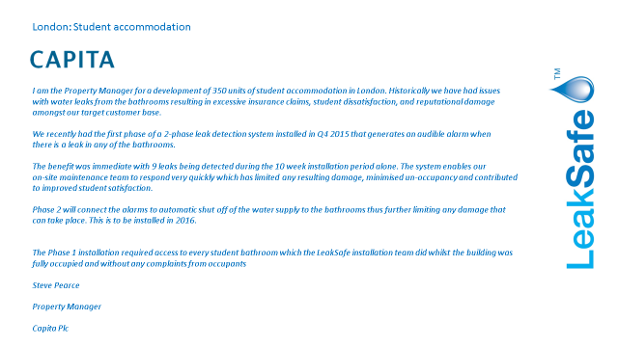

Slide 14
Office and retail development Leeds
Within one week of installation ……….
‘Last night, due to a sub-contractor affecting the water supply to the main tanks the 3 cores ran out of water. This was resolved quickly, however someone in core 3 when discovering there was no water, did not turn the tap off and the plug had been left in a sink. We received two messages in close succession from Leaksafe and managed to prevent a major flood. There are a few damaged ceiling tiles and a damp carpet in core 3 levels 2 & 3.
So definitely worth the investment.
Regards
Susan Mendoza
Centre Manager

Slide 15






LeakSafe: a wide range of Accreditations
Water efficient technology
Energy efficient products
Sustainable buildings
Independently tested & validated

Slide 16
The next two slides illustrate some of LeakSafe’s clients and the insurers who
Recommend/fund/require LeakSafe systems.
They would not deal with LeakSafe if their systems did not deliver the benefits

Slide 17












LeakSafe a proven trusted provider

Slide 18










LeakSafe: a proven trusted provider

